Slide 1
CPE 133
Review
Register
Verilog Sequential Circuit Models

Slide 2
Important Items
Everything you can do with a bit
Set, clear, toggle, nothing
Combinatorial Circuits:
outputs strictly a function of circuit inputs
no memory, (thus no state)
Sequential Circuits:
Outputs are a function of the “sequence” of inputs
Have memory (thus has state)
Modeling combinatorial circuits with Verilog
Must a catch-all statement

Slide 3
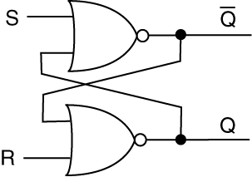
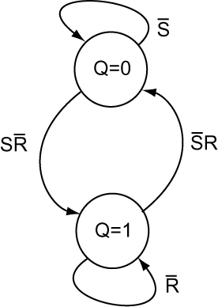
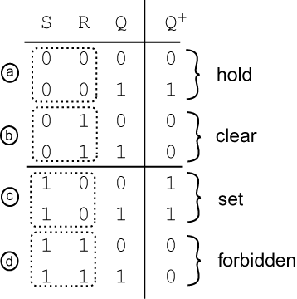
State Diagrams
Common way of modeling sequential circuits
Shows “important” states of circuit

Slide 4
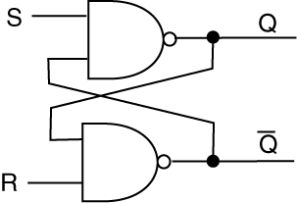
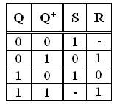
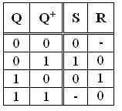
NAND & NOR Latches
NAND Latch
NOR Latch
Circuit Form
Block Diagram
Excitation Tables

Slide 5
D Flip-Flops (D for data)
Flip-flop: one-bit storage element
Sensitivity: when the output can change
Latch: level-sensitive 1-bit storage element
Output changes any time
Asynchronous circuit
Flip-flop: edge sensitive 1-bit storage element
Output can only change on “clock edge”
Synchronous circuit

Slide 6
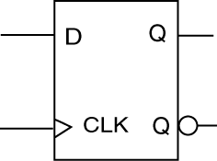
D Flip-flop
Synchronous circuit
Output changes are synchronized to active clock edge
Edge Trigger
Rising edge (RET)
Falling edge (FET)
Internal circuitry: very complicated
Circuit latches D input into memory element on active clock edge

Slide 7
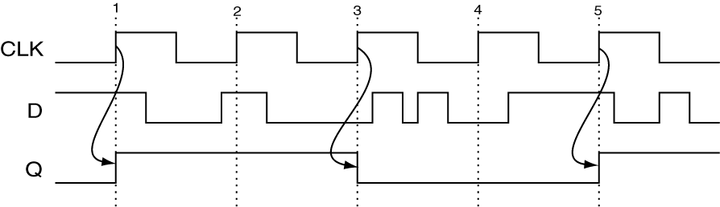
D Flip-flop Timing Diagram
Synchronous: output changes are synchronized to rising clock edge

Slide 8
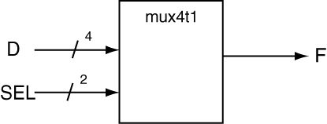
Verilog MUX Models
module mux_4t1_a(SEL, D, F);
input [1:0] SEL;
input [3:0] D;
output reg F;
always @(SEL, D)
begin
if (SEL == 0) F = D[0];
else if (SEL == 1) F = D[1];
else if (SEL == 2) F = D[2];
else if (SEL == 3) F = D[3];
else F = 0;
end
endmodule
module mux_4t1_a(SEL, D, F);
input [1:0] SEL;
input [3:0] D;
output reg F;
always @(SEL, D)
begin
if (SEL == 0) F = D[0];
else if (SEL == 1) F = D[1];
else if (SEL == 2) F = D[2];
else if (SEL == 3) F = D[3];
end
endmodule
If you don’t include a catchall, the synthesizer generates a latch!
Your circuit is “bigger” than it needs to be and probably wont’ work properly

Slide 9
SR Latch Verilog Model
---------------------------------------------
-- Model of an NOR-based SR Latch
---------------------------------------------
module sr_latch(S, R, Q);
input S, R;
output reg Q;
always @ (S, R)
begin
if (S == 0 && R == 1)
Q <= 1'b0;
else if (S == 1 && R == 0)
Q <= 1'b1;
end
endmodule
Note: there is no “catch-all”

Slide 10
Complete D Flip-flop model
module d_ff(D, CLK, Q);
input D, CLK;
output reg Q;
always @ (posedge CLK)
begin
Q <= D;
end
endmodule
posedge in sensitivity list: instructs the synthesize to induce memory
“<=“ indicates non-blocking assignment

Slide 11
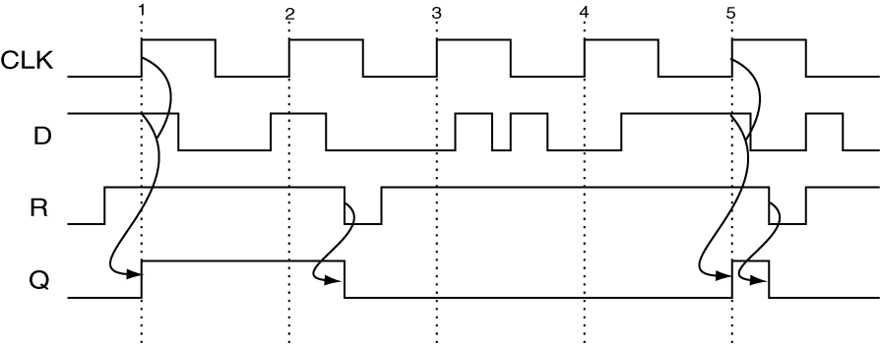
D FF with “other” control inputs as
Can have set and/or reset inputs
Not necessarily synchronous
R (reset) is asynchronous

Slide 12
D Flip-flop with asynchronous Clear
module d_ff_nclr_async(D, CLK, Q, CLR);
input D, CLK, CLR;
output reg Q;
always @ (negedge CLR, posedge CLK)
begin
if (CLR == 0)
Q <= 1'b0;
else
Q <= D;
end
endmodule

Slide 13
Blocking vs. Non Blocking Assignment
module d_ff_blocking(D,CLK,Q1,Q2);
input D, CLK;
output reg Q1, Q2;
//- blocking assignment
always @ (posedge CLK)
begin
Q1 = D;
Q2 = Q1;
end
endmodule
module d_ff_non_blocking(D,CLK,Q1,Q2);
input D, CLK;
output reg Q1, Q2;
//- non-blocking assignment
always @ (posedge CLK)
begin
Q1 <= D;
Q2 <= Q1;
end
endmodule
Synthesized circuits

Slide 14
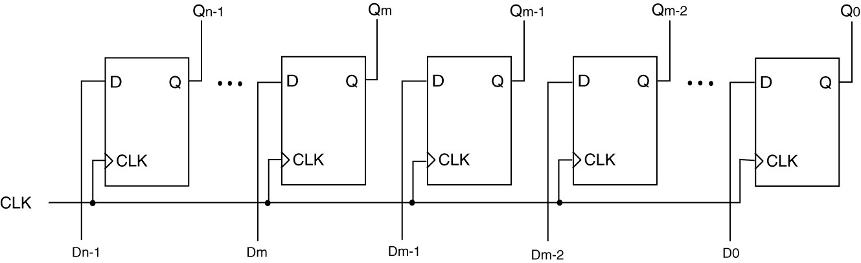
Generic Register: n-bit Storage Element
Block Diagram
Underlying Circuit Diagram

Slide 15
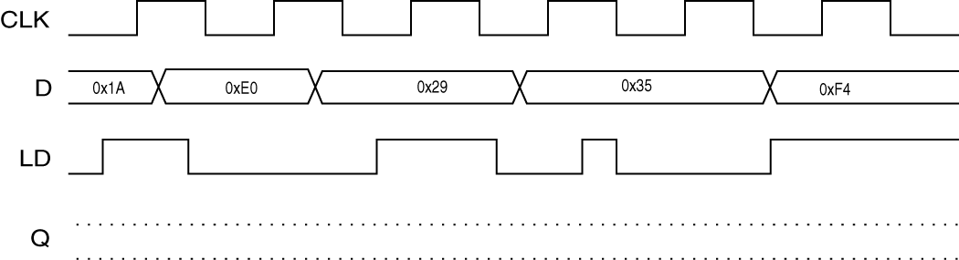
Register with Load Control
Block Diagram
Timing Diagram Example

Slide 16
D Flip-flop with asynchronous Clear
module reg_nb(data_in, clk, clr, ld., data_out);
input [n-1:0] data_in;
input clk, clr, ld;
output reg [n-1:0] data_out;
parameter n = 8;
always @(posedge clr, posedge clk)
begin
if (clr == 1) // asynch clr
data_out <= 0;
else if (ld == 1)
data_out <= data_in;
end
endmodule

Slide 17
Digital Design Foundation Model
Generic Register
Data: DATA_IN: data to be loaded into register
Data: DATA_OUT: Data currently stored by register
Control: CLR: make register store all zeros
Control: LD: must be asserted to store DATA_IN to register
Control: CLK: synchronizes most register operations

Slide 18
Summary of Important Stuff
Use of posedge and/or negedge in sensitivity list causes synthesizer create a sequential circuit
Two types of procedural assignment statements (statements used inside of always blocks)
blocking & non-blocking
Use blocking statement for combinatorial circuits
Use non-blocking statements for sequential circuits

Slide 19
Verilog MUX Models
module mux_4t1_a(SEL, D, F);
input [1:0] SEL;
input [3:0] D;
output reg F;
always @(SEL, D)
begin
if (SEL == 0) F = D[0];
else if (SEL == 1) F = D[1];
else if (SEL == 2) F = D[2];
else if (SEL == 3) F = D[3];
else F = 0;
end
endmodule
module d_ff_nclr_async(D, CLK, Q, CLR);
input D, CLK, CLR;
output reg Q;
always @ (negedge CLR, posedge CLK)
begin
if (CLR == 0)
Q <= 1'b0;
else
Q <= D;
end
endmodule
Sequential: non-blocking
Combinatorial: blocking

